Slide 1
ENTERPRISE RESOURCE PLANNING
Presented By
Meghana Gamidi

Slide 2
Enterprise Resource Planning :
ERP Software is an integrated Suit for various Business applications in a Organization.
ERP has many modules of the organizations to talk to each other possibly under a single data base.
ERP refers to a type of software that organizations use to manage day-to-day business activities such as accounting, procurement, project management, risk management and compliance, and supply chain operations.

Slide 3
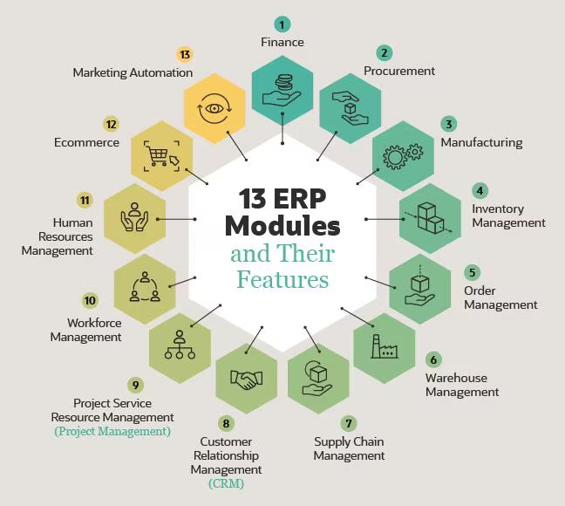

ERP Features :
Finance Management
Procurement Management
Manufacturing
Inventory Management
Order Management
Warehouse Management
Supply Chain Management
Customer Relationship Management
Project Service Resource Management
Workforce Management
Human Resources Management
E-Business Or e- Commerce
Marketing Automation

Slide 4
TIME MANGEMENT
1. Time Management (WBS Structure)
2. Total Project Time
3. Gantt chart view

Slide 5
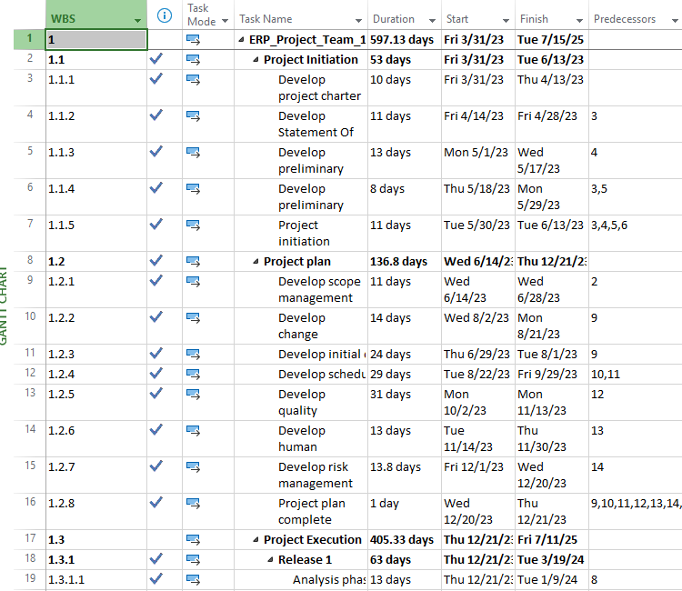
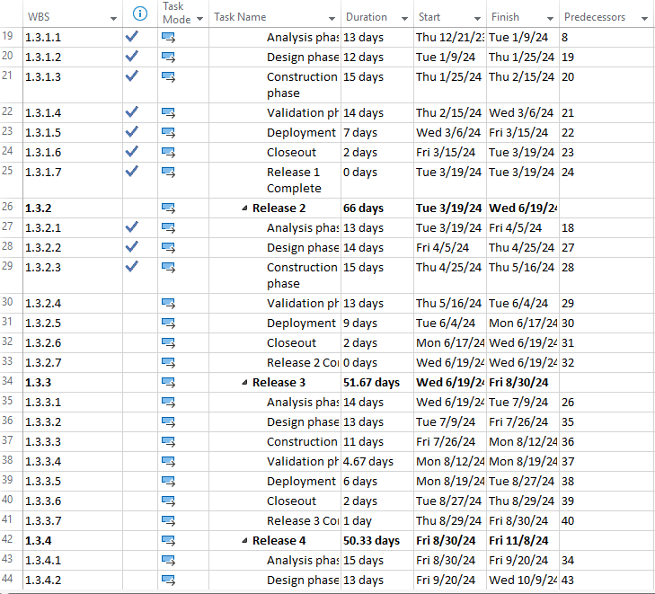
1. Time Management plan (WBS structure)

Slide 6
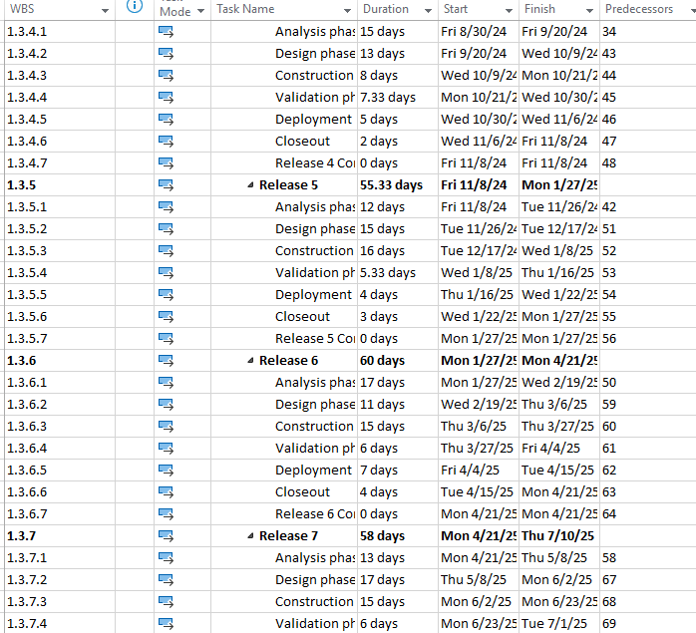
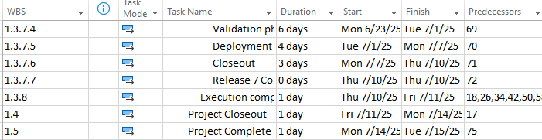
1. Time Management plan (WBS structure)

Slide 7
2. Total Project Time
Project Phases | Start | Finish | Duration
Project Initiation | 3/31/23 | 6/13/23 | 53 days
Project plan | 6/14/23 | 12/21/23 | 136.8 days
Release 1 | 12/21/23 | 3/19/24 | 63 days
Release 2 | 3/19/24 | 6/19/24 | 66 days
Release 3 | 6/19/24 | 8/30/24 | 51.67 days
Release 4 | 8/30/24 | 11/8/24 | 50.33 days
Release 5 | 11/8/24 | 1/27/25 | 55.33 days
Release 6 | 1/27/25 | 4/21/25 | 60 days
Release 7 | 4/21/25 | 7/10/25 | 58 days
Total Project Time | 3/31/23 | 7/15/25 | 597.13 days

Slide 8
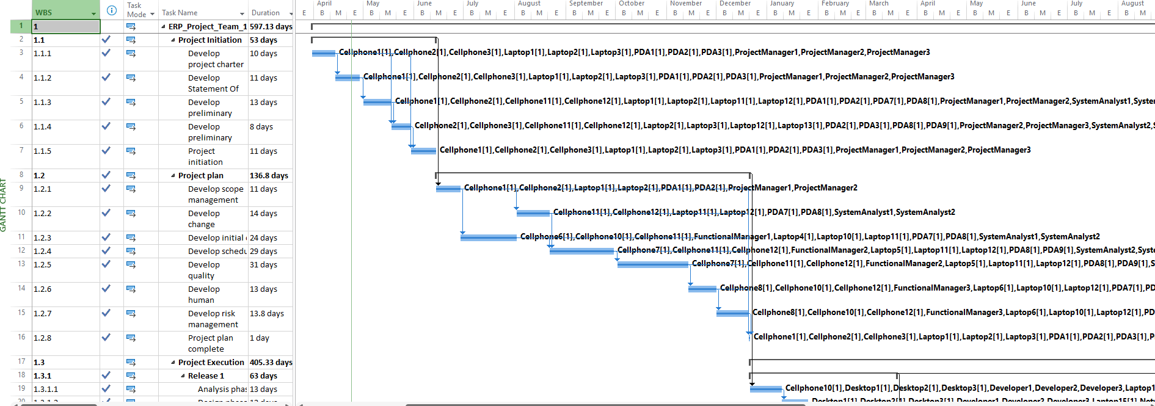
3. Gantt View

Slide 9
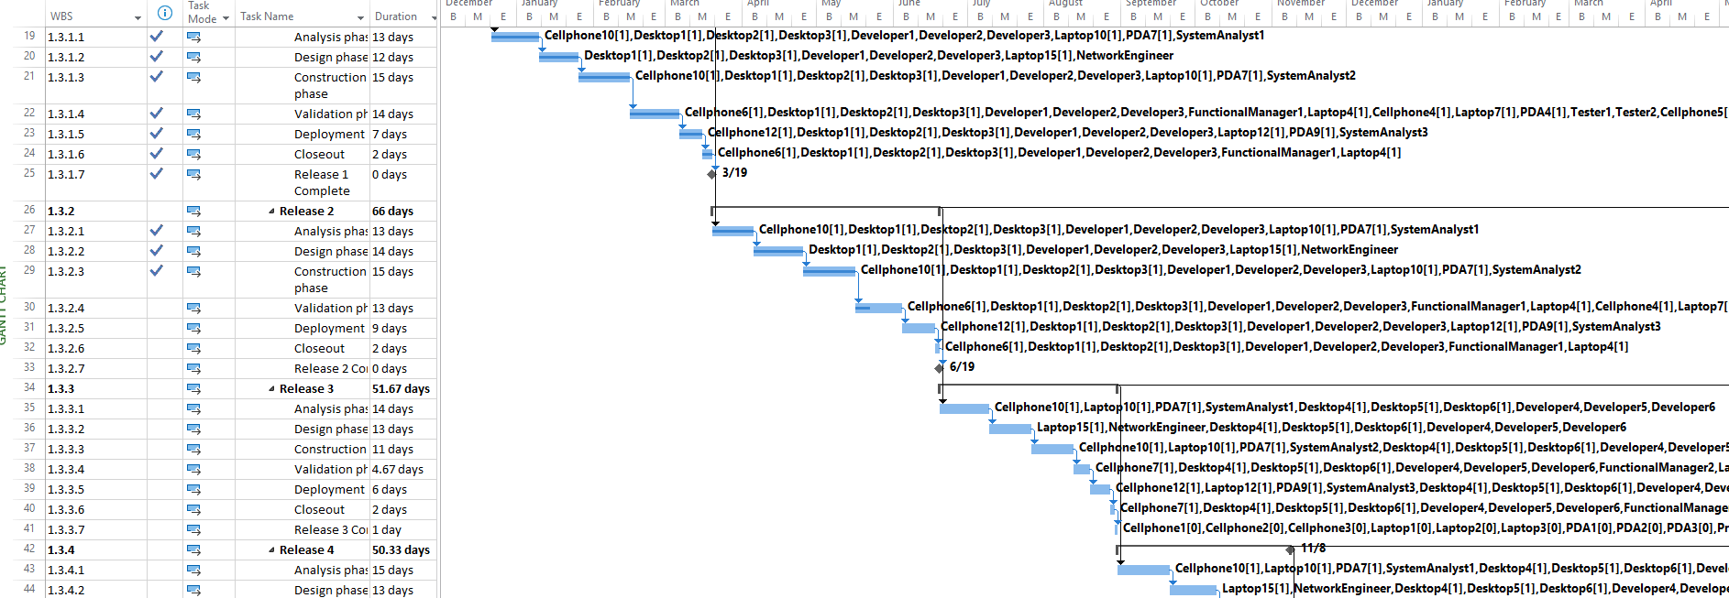
3. Gantt View

Slide 10
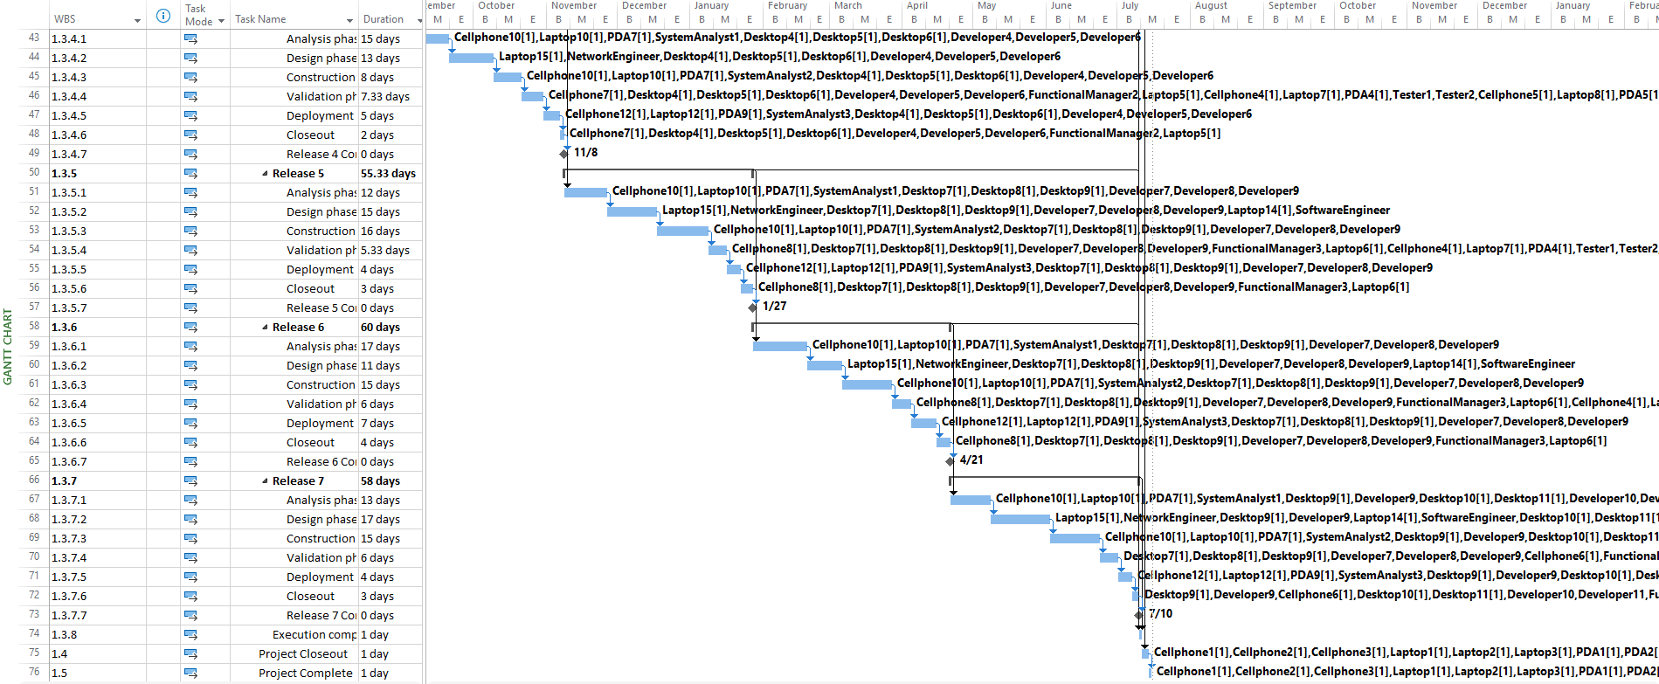
3. Gantt View

Slide 11
HUMAN RESOURCE MANGEMENT
1. Roles and Responsibility Matrix
2. Human Resources and Associated Material Resources
3. List of Resources Assigned in Different Phases of the Project

Slide 12
1. Roles and Responsibility Matrix

Slide 13
2. Human Resources and Associated Material Resources
Human Resources | Associated Material Resources
Project Manager1 | Laptop1,Cellphone1,PDA1
Project Manager2 | Laptop2,Cellphone2,PDA2
Project Manager 3 | Laptop3,Cellphone3,PDA3
Functional Manager 1 | Laptop4,Cellphone6
Functional Manager 2 | Laptop5,Cellphone7
Functional Manager 3 | Laptop6,Cellphone8
Tester 1 | Laptop7,Cellphone4,PDA4
Tester 2 | Laptop8,Cellphone5,PDA5
Security Analyst | Laptop9,Cellphone9,PDA6
System Analyst1 | Laptop10,Cellphone10,PDA7
System Analyst2 | Laptop11,Cellphone11,PDA8
System Analyst3 | Laptop12,Cellphone12,PDA9
Security Engineer | Laptop13
Software Engineer | Laptop14
Network Engineer | Laptop15
Developer1 | Desktop1
Developer2 | Desktop2
Developer3 | Desktop3
Developer4 | Desktop4
Developer5 | Desktop5
Developer6 | Desktop6
Developer7 | Desktop7
Developer8 | Desktop8
Developer9 | Desktop9
Developer10 | Desktop10
Developer11 | Desktop11
Developer 12 | Desktop12
Project Manager 4 | Laptop17,Cellphone 14, PDA11
Tester 3 | Laptop 16, Cellphone 13,PDA10
System Analyst4 | Laptop18,Cellphone15,PDA12

Slide 14
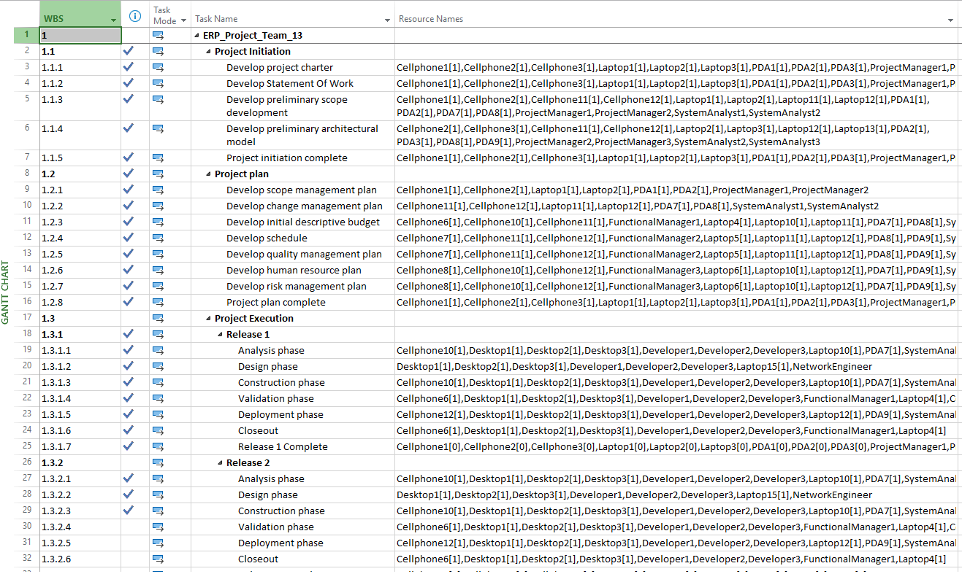
3. List of Resources Assigned in Different Phases of the Project

Slide 15
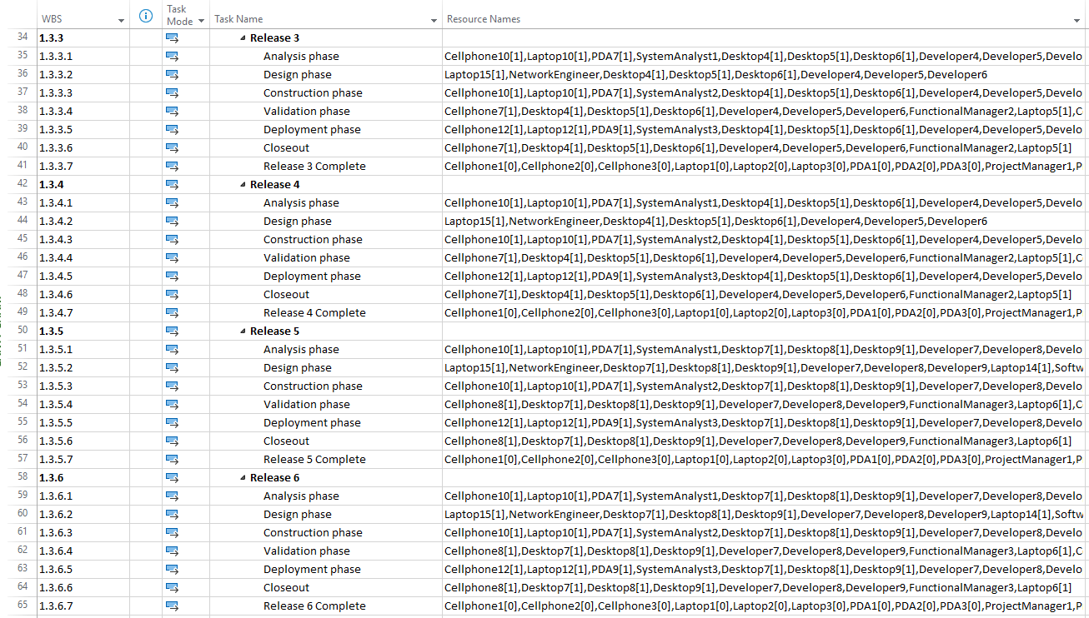
3. List of Resources Assigned in Different Phases of the Project

Slide 16
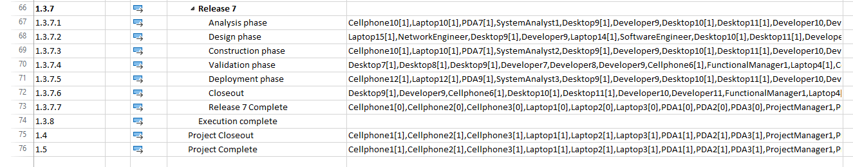
3. List of Resources Assigned in Different Phases of the Project

Slide 17
Cost MANGEMENT
1. Human Resource with salaries
2. Material Resources with costs
3. Total Budget Plan

Slide 18
1. Human Resources with Salaries
Resource Name | Std. Rate
Project Manager1 | $69.95/hr
Project Manager2 | $59.40/hr
Project Manager 3 | $57.75/hr
Functional Manager 1 | $52.00/hr
Functional Manager 2 | $52.00/hr
Functional Manager 3 | $52.00/hr
Tester1 | $39.00/hr
Tester2 | $37.65/hr
Security Analyst | $53.25/hr
System Analyst1 | $54.30/hr
System Analyst2 | $50.70/hr
System Analyst3 | $49.95/hr
Security Engineer | $57.50/hr
Network Engineer | $51.00/hr
Developer1 | $54.75/hr
Developer2 | $53.90/hr
Developer3 | $54.15/hr
Resource Name | Std. Rate
Developer4 | $53.20/hr
Developer5 | $53.65/hr
Developer6 | $55.00/hr
Developer7 | $54.30/hr
Developer8 | $53.00/hr
Developer9 | $55.15/hr
Developer10 | $53.45/hr
Developer11 | $54.50/hr
Developer12 | $53.50/hr
Project Manager 4 | $59.45/hr
Tester3 | $38.65/hr
System Analyst4 | $52.70/hr

Slide 19
2. Material Resources with costs
19
Resource Name | Std. Rate
Cellphone1 | $800.00
Cellphone2 | $800.00
Cellphone3 | $800.00
Cellphone4 | $800.00
Cellphone5 | $800.00
Cellphone6 | $800.00
Cellphone7 | $800.00
Cellphone8 | $800.00
Cellphone9 | $800.00
Cellphone10 | $800.00
Cellphone11 | $800.00
Cellphone12 | $800.00
Cellphone13 | $800.00
Cellphone14 | $800.00
Cellphone15 | $800.00
Desktop1 | $1,250.00
Desktop2 | $1,250.00
Desktop3 | $1,250.00
Desktop4 | $1,250.00
Desktop5 | $1,250.00
Resource Name | Std. Rate
Desktop6 | $1,250.00
Desktop7 | $1,250.00
Desktop8 | $1,250.00
Desktop9 | $1,250.00
Desktop10 | $1,250.00
Desktop11 | $1,250.00
Desktop12 | $1,250.00
Laptop1 | $1,300.00
Laptop2 | $1,300.00
Laptop3 | $1,300.00
Laptop4 | $1,300.00
Laptop5 | $1,300.00
Laptop6 | $1,300.00
Laptop7 | $1,300.00
Laptop8 | $1,300.00
Laptop9 | $1,300.00
Laptop10 | $1,300.00

Slide 20
2. Material Resources with costs
20
Resource Name | Std. Rate
Laptop11 | $1,300.00
Laptop12 | $1,300.00
Laptop13 | $1,300.00
Laptop14 | $1,300.00
Laptop15 | $1,300.00
Laptop16 | $1,300.00
Laptop17 | $1,300.00
Laptop18 | $1,300.00
PDA1 | $270.00
PDA2 | $270.00
PDA3 | $270.00
PDA4 | $270.00
PDA5 | $270.00
PDA6 | $270.00
PDA7 | $270.00
PDA8 | $270.00
PDA9 | $270.00
PDA10 | $270.00
PDA11 | $270.00
PDA12 | $270.00

Slide 21
3. Total Budget Plan
21
Phases | Total Project Cost($) | Actual Cost($) | Remaining Cost($)
Project Initiation | $ 126,499.20 | $126,499.20 | $ 0.00
Project plan | $ 228,242.40 | $228,242.40 | $ 0.00
Project Execution | $ 1,030,192.67 | $257,851.14 | $ 772,341.52
Release 1 | $ 156,566.40 | $156,566.40 | $ 0.00
Release 2 | $ 161,059.60 | $101,284.74 | $ 59,774.86
Release 3 | $ 130,829.73 | $ 0.00 | $ 130,829.73
Release 4 | $ 130,463.87 | $ 0.00 | $ 130,463.87
Release 5 | $ 146,143.07 | $ 0.00 | $ 146,143.07
Release 6 | $ 152,796.80 | $ 0.00 | $ 152,796.80
Release 7 | $ 152,333.20 | $ 0.00 | $ 152,333.20
Total Project Cost | $ 1,402,147.87 | $612,592.74 | $ 789,555.12

Slide 22
Risk MANGEMENT
1. Risk Management : Decision Tree with EMV
2. Risk Exposure Table
3. Risk Impact Probability Matrix
4. Risk Comparison Table with Graphs

Slide 23
1. Decision Tree with EMV
23
Complete Failure
1.402(0.1)
=-0.1402M
In Source
(investment 1.402M)
0.1
1.402(0.2)
=0.2804M
0.2
Partial Success
1.402(0.7)
=0.9814M
0.7
Complete Success
1.402(0.7)
=0.9814M
In Source or Outsource
Total=1.1216M
Complete Failure
0.701(0.3)
=-0.15M
Out Source
(investment 0.701M)
0.3
0.7
Complete Success
0.701(0.7)
=0.4907M
Total=0.3407M

Slide 24
2. Risk Exposure Table
24
Risk No. | Risk Drivers | Risk Probability (RP) | Risk Impact (RI) | Risk Exposure (RP * RI)
1 | Expeience and Teaming | Medium (0.5) | Medium (0.5) | 0.25
2 | Requirements and Design | Medium (0.5) | Medium High (0.7) | 0.35
3 | Planning | Medium Low (0.3) | Medium Low (0.3) | 0.09
4 | Testing | Medium (0.5) | Medium High(0.7) | 0.35
5 | Tools | Low (0.1) | Medium Low (0.3) | 0.03
6 | Schedule | Medium High (0.7) | Medium Low (0.3) | 0.21
 | Total Risk Adjustment Factor |  |  | 1.28

Slide 25
3. Risk Impact Probability Matrix
25
Risk No. | Risk Drivers | Description | Risk Probability (RP) | Risk Impact (RI) | Risk Exposure (RP * RI)
1 | Expeience and Teaming | Limited software experience in the project office. Software staff not included in early planning and design decisions. | Medium (0.5) | Medium High (0.7) | 0.35
2 | Requirements and Design | Systems decisions made without accounting for impact on software Poor scope definition. | Medium (0.5) | High (0.9) | 0.45
3 | Planning | Lack of appropriate planning detail with insufficient reviews. Unclear SOW and WBS. | Medium Low (0.3) | Medium Low (0.3) | 0.09
4 | Testing | Plan to convert SW test documents not due till very late in the life-cycle. Developers into test team late in life-cycle. | Medium High (0.7) | Medium High (0.7) | 0.49
5 | Tools | Limited test analysis tools. Unproven design tools selected with limited time for analysis. | Low (0.1) | Medium Low (0.3) | 0.03
6 | Schedule | Schedule changes - with the possibility of scope changes and other issues, schedule changes may also be needed. | Medium High (0.7) | Medium Low (0.3) | 0.21
 |  | Total Risk Adjustment Factor |  |  | 1.62

Slide 26
3. Risk Impact Probability Matrix
26
Probability Impact | Low | Low Medium | Medium | Medium High | High
Low |  | 5
Medium Low | 3
Medium
Medium High |  | 6 | 1 | 4
High |  |  | 2

Slide 27
7.4 Risk Comparison Table with Graphs
27
Case # | Project Total Cost | Risk Factor | Duration (Days) | Probability | Expected Value
 | (Data will be obtained during Lab 3) | (Data must be calculated before the Lab 3) | (Data will be obtained during Lab 3) | (Data will be given by Instructor before Lab 3) | (Data will be calculated during Lab 3)
0 | $1,402,147.87 | 1.62 | 597.13
1 (Remove 1 expert (8-9 yrs exp) - 1SA) | $1,384,428.67 | 1.9 | 597.13 | Partial Failure (35%) | ($6,201.72)
2 (Remove 2 experts(8-9 yrs exp) 1SA, 1 Devloper) | $1,368,992.67 | 2.2 | 597.13 | Complete Failure (30%) | ($9,946.56)
3 (add experts - 1tester, 1developer) | $1,410,009.68 | 0.94 | 599.98 | Complete Success (15%) | $1,179.27
4(add beginners - 1PM, 1SA, 1tester, 1 developer) | $1,431,855.28 | 1.28 | 599.98 | Partial Success (20%) | $5,941.48
 |  |  |  | EMV | ($9,027.53)
 |  |  |  | Total EMV | $1,393,120.34
 |  |  |  | Conclusion: | So from risk perspective , this project is worth doing as $9,027.53 is nearly 0.7% of the total cost

Slide 28
4. Risk Comparison Table with Graphs
28

